Slide 1
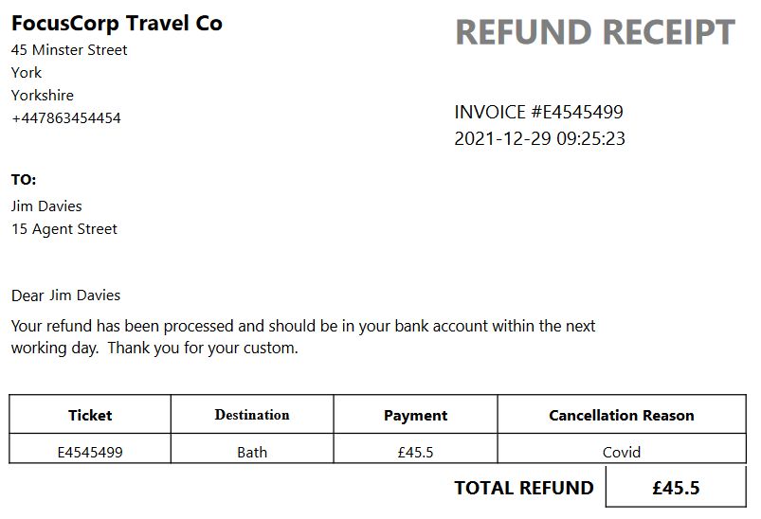
Creating
RPA
Reports
Nigel T. Crowther
EMEA Tech Sales

Slide 2
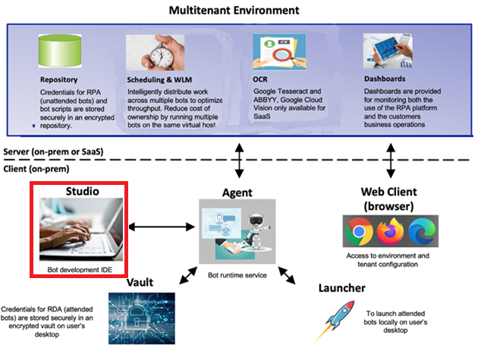
Note that this lab only touches the surface of RPA reports. For detailed training
Creating
Reports
Reports are created in RPA Studio.
For more training, see:
https://learn.ibm.com/course/view.php?id=8695
2
IBM Automation / © 2022 IBM Corporation
2
Notes:
IBM, it’s clients and many industry participants see a clear path towards resiliency that leverages the most efficient and effective technologies for more agile, adaptive and resilient processes.
Automation enables customers to digitize their operations with low-code, cloud-ready containerized automation software.
Next, Automation applies AI in practical ways so you don’t need a data scientist. Things like, Document Understanding, Next Best Tasks. These build on your existing Digitization efforts with Cloud Pak for Automation.
Now you can offload work with our Digital Workers. Digital Workers without AI is just simple RPA/task automation.
We are in a crisis now but these are the things to do for long-term success, as well.

Slide 3
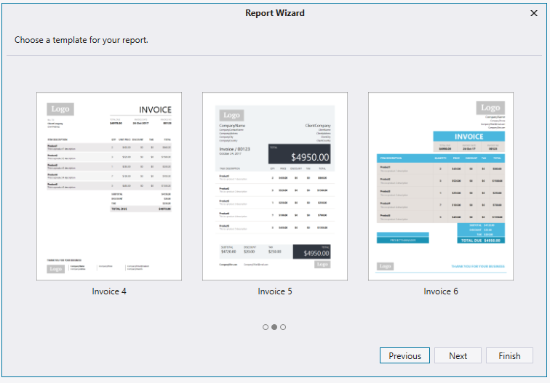
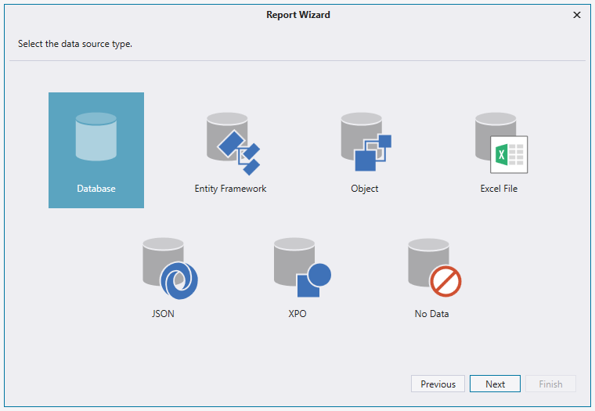
Report Wizard
The report designer has templates, so you don’t need to start from scratch:
Use the Report Wizard to expedite report creation
You can pull report data from multiple data sources:
Database
Excel
Parameters passed in from bot
JSON
IBM Automation / © 2022 IBM Corporation
3
Notes:
IBM, it’s clients and many industry participants see a clear path towards resiliency that leverages the most efficient and effective technologies for more agile, adaptive and resilient processes.
Automation enables customers to digitize their operations with low-code, cloud-ready containerized automation software.
Next, Automation applies AI in practical ways so you don’t need a data scientist. Things like, Document Understanding, Next Best Tasks. These build on your existing Digitization efforts with Cloud Pak for Automation.
Now you can offload work with our Digital Workers. Digital Workers without AI is just simple RPA/task automation.
We are in a crisis now but these are the things to do for long-term success, as well.

Slide 4

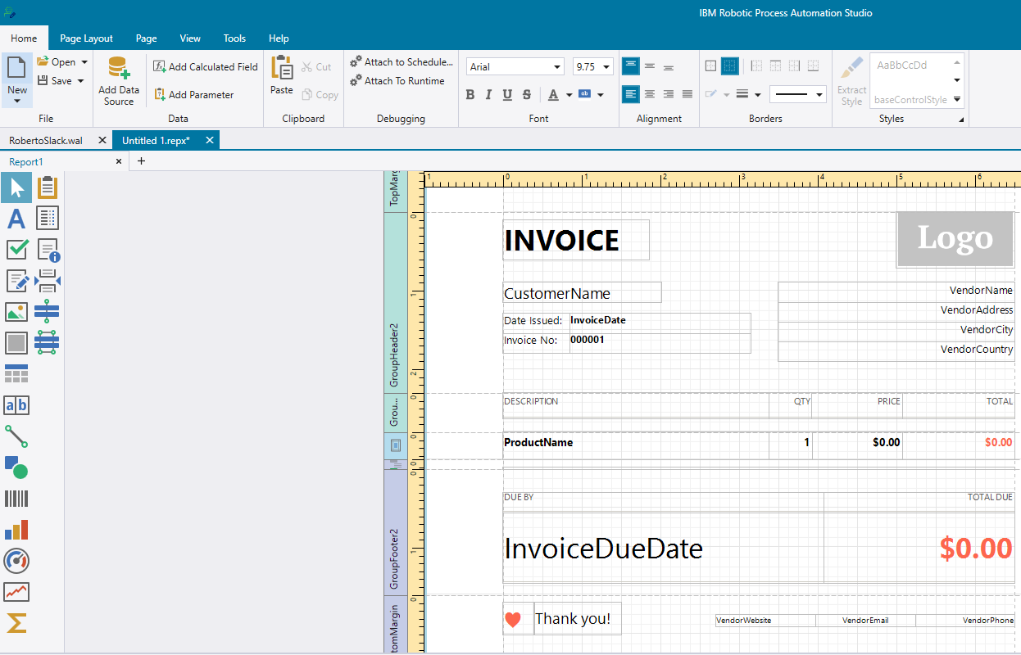
Report
Designer
Build the report visually
Map fields to a data source
IBM Automation / © 2022 IBM Corporation
4
Notes:
IBM, it’s clients and many industry participants see a clear path towards resiliency that leverages the most efficient and effective technologies for more agile, adaptive and resilient processes.
Automation enables customers to digitize their operations with low-code, cloud-ready containerized automation software.
Next, Automation applies AI in practical ways so you don’t need a data scientist. Things like, Document Understanding, Next Best Tasks. These build on your existing Digitization efforts with Cloud Pak for Automation.
Now you can offload work with our Digital Workers. Digital Workers without AI is just simple RPA/task automation.
We are in a crisis now but these are the things to do for long-term success, as well.

Slide 5
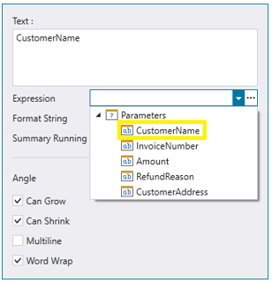
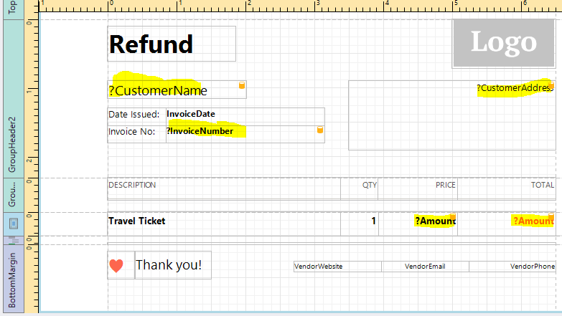
Report
Designer
Map report fields to a data source
IBM Automation / © 2022 IBM Corporation
5
Notes:
IBM, it’s clients and many industry participants see a clear path towards resiliency that leverages the most efficient and effective technologies for more agile, adaptive and resilient processes.
Automation enables customers to digitize their operations with low-code, cloud-ready containerized automation software.
Next, Automation applies AI in practical ways so you don’t need a data scientist. Things like, Document Understanding, Next Best Tasks. These build on your existing Digitization efforts with Cloud Pak for Automation.
Now you can offload work with our Digital Workers. Digital Workers without AI is just simple RPA/task automation.
We are in a crisis now but these are the things to do for long-term success, as well.

Slide 6

Report
Designer
Save the report as an asset inside your bot
IBM Automation / © 2022 IBM Corporation
6
Notes:
IBM, it’s clients and many industry participants see a clear path towards resiliency that leverages the most efficient and effective technologies for more agile, adaptive and resilient processes.
Automation enables customers to digitize their operations with low-code, cloud-ready containerized automation software.
Next, Automation applies AI in practical ways so you don’t need a data scientist. Things like, Document Understanding, Next Best Tasks. These build on your existing Digitization efforts with Cloud Pak for Automation.
Now you can offload work with our Digital Workers. Digital Workers without AI is just simple RPA/task automation.
We are in a crisis now but these are the things to do for long-term success, as well.

Slide 7
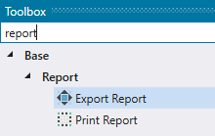
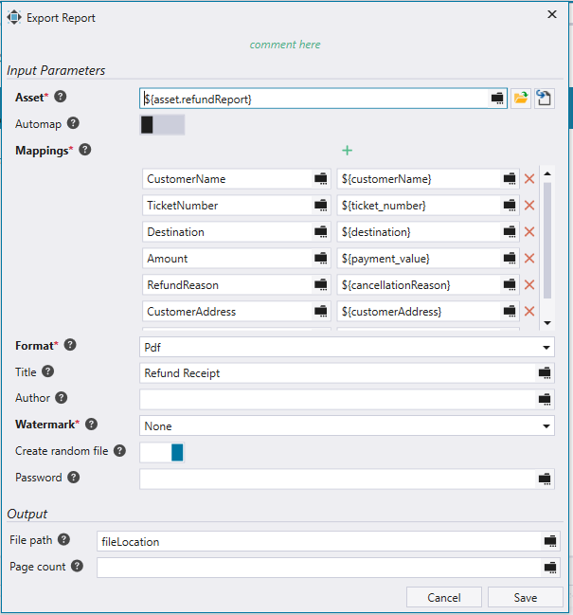
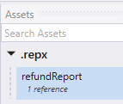
Wal Commands
IBM Automation / © 2022 IBM Corporation
7
Notes:
IBM, it’s clients and many industry participants see a clear path towards resiliency that leverages the most efficient and effective technologies for more agile, adaptive and resilient processes.
Automation enables customers to digitize their operations with low-code, cloud-ready containerized automation software.
Next, Automation applies AI in practical ways so you don’t need a data scientist. Things like, Document Understanding, Next Best Tasks. These build on your existing Digitization efforts with Cloud Pak for Automation.
Now you can offload work with our Digital Workers. Digital Workers without AI is just simple RPA/task automation.
We are in a crisis now but these are the things to do for long-term success, as well.

Slide 9
Reporting
Lab 3
Reporting
IBM Automation / © 2022 IBM Corporation
9
Notes:
IBM, it’s clients and many industry participants see a clear path towards resiliency that leverages the most efficient and effective technologies for more agile, adaptive and resilient processes.
Automation enables customers to digitize their operations with low-code, cloud-ready containerized automation software.
Next, Automation applies AI in practical ways so you don’t need a data scientist. Things like, Document Understanding, Next Best Tasks. These build on your existing Digitization efforts with Cloud Pak for Automation.
Now you can offload work with our Digital Workers. Digital Workers without AI is just simple RPA/task automation.
We are in a crisis now but these are the things to do for long-term success, as well.

Slide 11
Reporting
IBM Automation / © 2022 IBM Corporation
11
Notes:
IBM, it’s clients and many industry participants see a clear path towards resiliency that leverages the most efficient and effective technologies for more agile, adaptive and resilient processes.
Automation enables customers to digitize their operations with low-code, cloud-ready containerized automation software.
Next, Automation applies AI in practical ways so you don’t need a data scientist. Things like, Document Understanding, Next Best Tasks. These build on your existing Digitization efforts with Cloud Pak for Automation.
Now you can offload work with our Digital Workers. Digital Workers without AI is just simple RPA/task automation.
We are in a crisis now but these are the things to do for long-term success, as well.

